Slide 1
^{Capstone Project-3}
^{Mobile Price Range Prediction}
^{Individual Project}
Ramji seth
ramjiseth9755@gmail.com

Slide 2
Problem statement
In the competitive mobile phone market companies want to understand sales data of mobile phones and factors which drive the prices.
The objective is to find out some relation between features of a mobile phone(eg:- RAM,Internal Memory, etc) and its selling price. In this problem, we do not have to predict the actual price but a price range indicating how high the price is.

Slide 3
Points to discuss
● Data description and summary
● Exploratory data analysis
● Heat map
● Machine learning algorithms
1.Logistic regression
2.Decision tree
3.Random forest classifier
4.Xgboost classifier
● conclusion

Slide 4
Data Description
The data contains information regarding mobile phone features, specifications etc and their price range. The various features and information can be used to predict the price range of a mobile phone.
● Battery_power - Total energy a battery can store in one time measured in mAh
● Blue - Has bluetooth or not
● Clock_speed - speed at which microprocessor executes instructions
● Dual_sim - Has dual sim support or not
● Fc - Front Camera mega pixels
● Four_g - Has 4G or not
● Int_memory - Internal Memory in Gigabytes
● M_dep - Mobile Depth in cm
● Mobile_wt - Weight of mobile phone

Slide 5
Data description(cont,.)
● N_cores - Number of cores of processor
● Pc - Primary Camera mega pixels
● Px_height - Pixel Resolution Height
● Px_width - Pixel Resolution Width
● Ram - RandomAccess Memory in Mega Bytes
● Sc_h - Screen Height of mobile in cm
● Sc_w - Screen Width of mobile in cm
● Talk_time - longest time that a single battery charge will last when you are
● Three_g - Has 3G or not
● Touch_screen - Has touch screen or not
● Wifi - Has wifi or not
● Price_range - This is the target variable with value of 0(low cost), 1(medium cost),
2(high cost) and 3(very high cost).

Slide 6
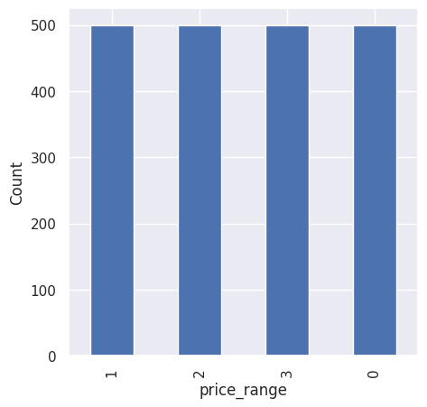
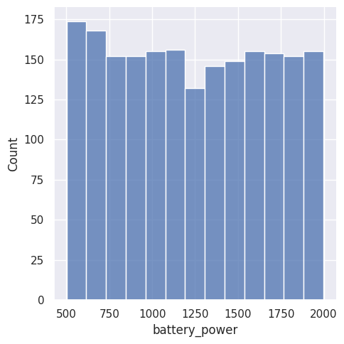
Exploratory Data Analysis
Price
Battery
There are mobile phones in 4 price ranges. the number of elements is almost similar
This plot shows how the battery mAh is spread. there is a gradual increase as the price range increases

Slide 7
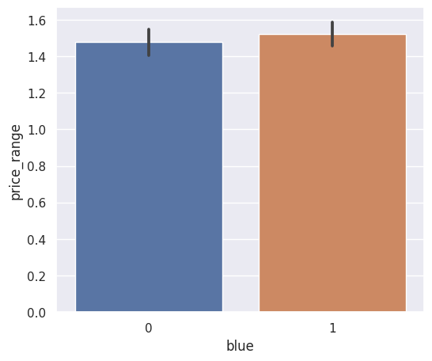
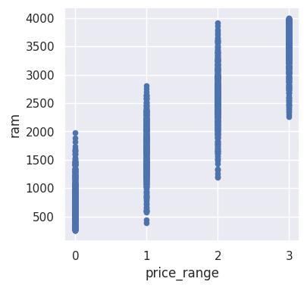
Bluetooth
RAM
● Half the devices have Bluetooth, and half don’t
● Ram has continuous increase with price range while moving from Low cost to Very high cost

Slide 8
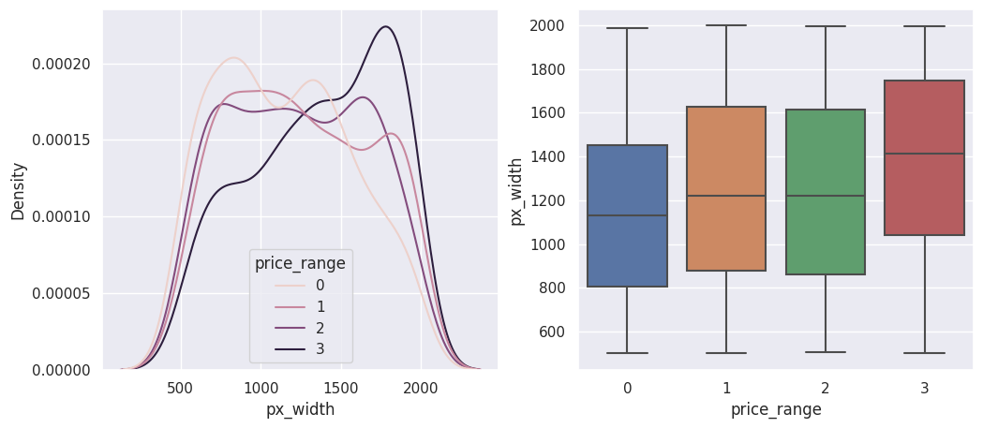
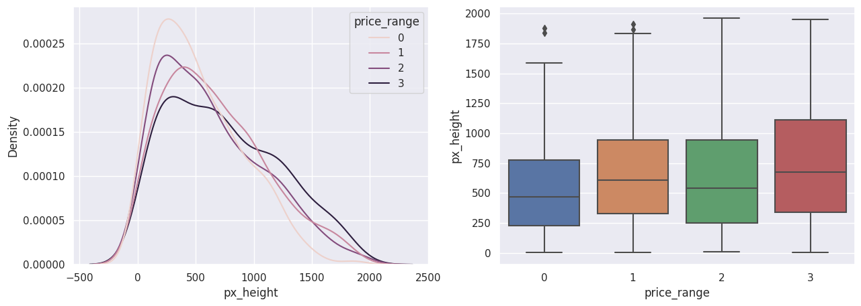
Px_width
Px_height
● There is not a continuous increase in pixel width as we move from Low cost to Very high cost. Mobiles with 'Medium cost' and 'High cost' has almost equal pixel width. so we can say that it would be a driving factor in deciding price_range.
● Pixel height is almost similar as we move from Low cost to Very high cost. Little variation in pixel_height

Slide 9
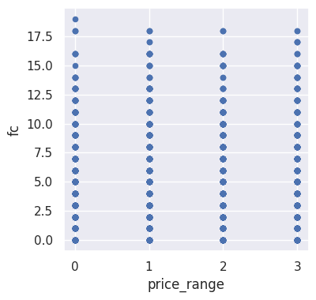
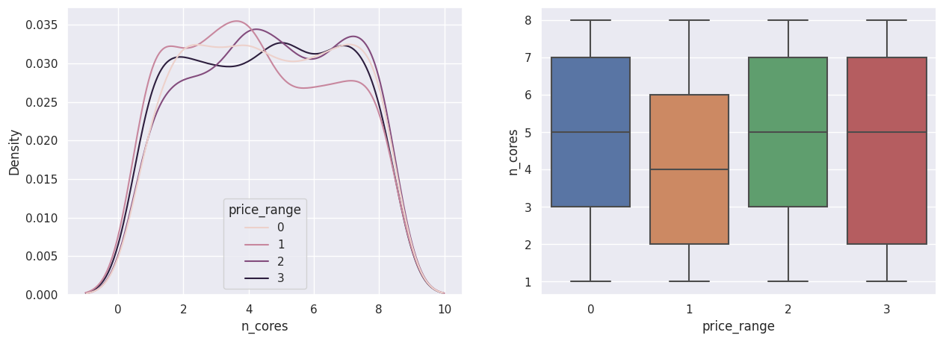
^{FC (front camera megapixels)}
PC (Primary camera Megapixels )
● This features distribution is almost similar along all the price ranges variable, it may not be helpful in making predictions
● Primary camera megapixels are showing a little variation along the target categories, which is a good sign for prediction.

Slide 10
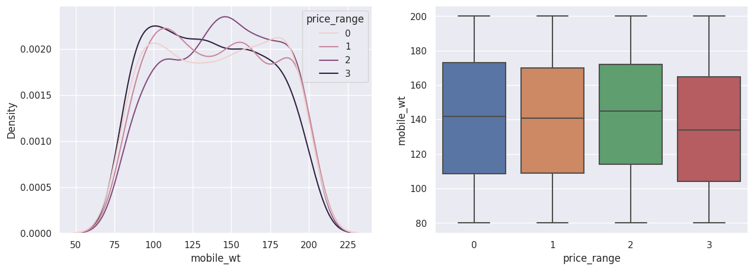
Mobile Weight
^{● Costly phones are lighter}

Slide 11
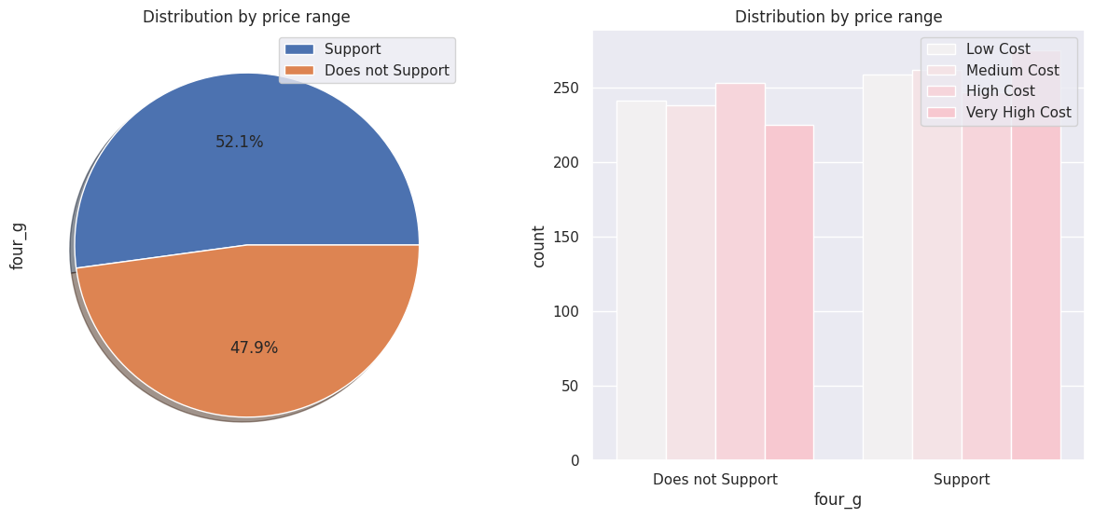
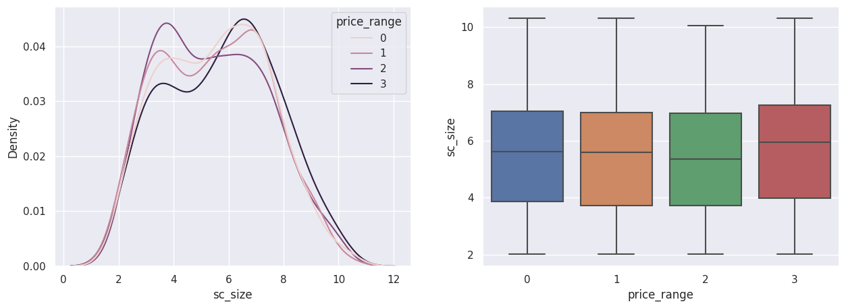
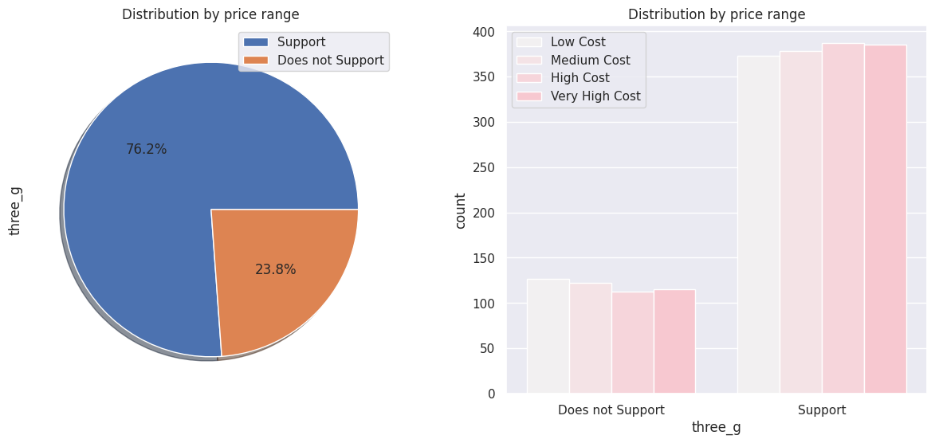
screen_size
4G And 3G
Combining the sc_height and sc_width into one column
that is sc_size, Screen Size shows little variation along the target variables. This can be helpful in predicting the target categories
.
● 50% of the phones support 4_g and 76% of phones support 3_g,feature 'three_g' play an important feature in prediction

Slide 12
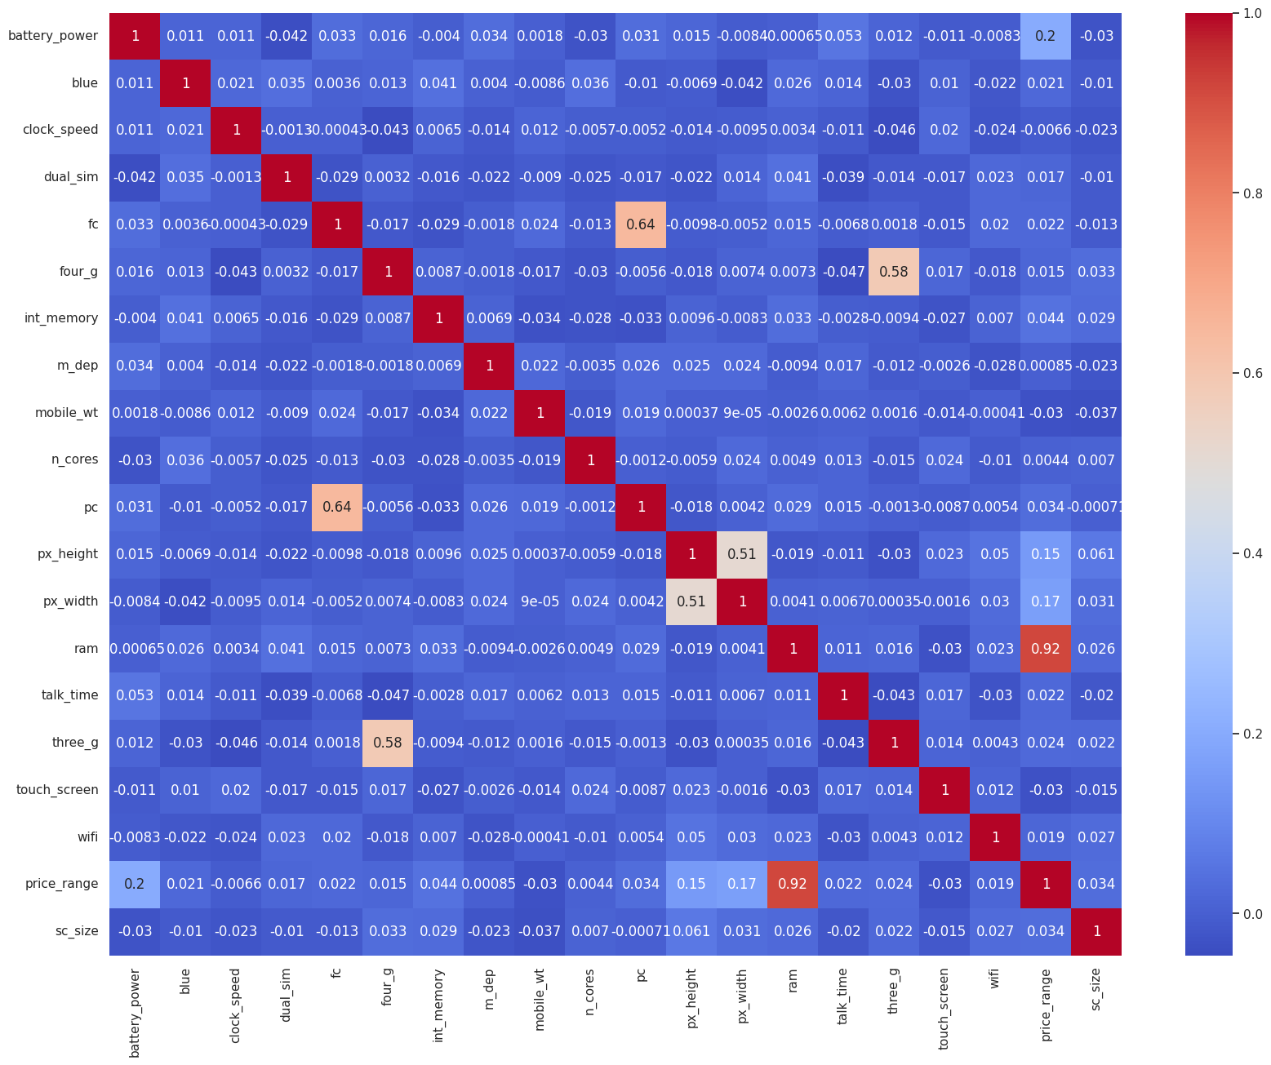
HEAT MAP
● RAM and price_range shows high correlation which is a good sign, it signifies that RAM will play major deciding factor in estimating the price range.
● There is some collinearity in feature pairs ('pc’,'fc') and ('px_width', 'px_height'). Both correlations are justified since there are good chances that if front camera of a phone is good, the back camera would also be good.
● Also, if px_height increases, pixel width also increases, that means the overall pixels in the screen. We can replace these two features with one feature. Front Camera megapixels and Primary camera megapixels are different entities despite of showing colinearity. So we'll be keeping them as they are.

Slide 13
ML algorithms
^{1.Logistic regression}
^{2. Decision tree}
3. Random Forest classification
^{4. XGboost}

Slide 14
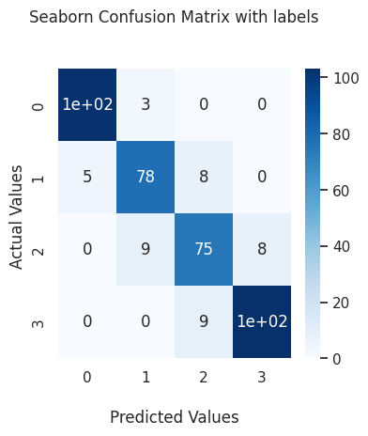
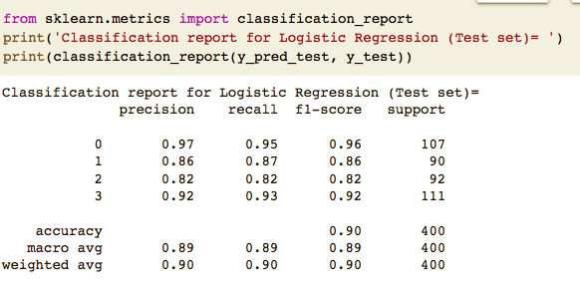
● Logistic Regression
Train_accuracy : 92% Test_accuracy: 90%

Slide 15
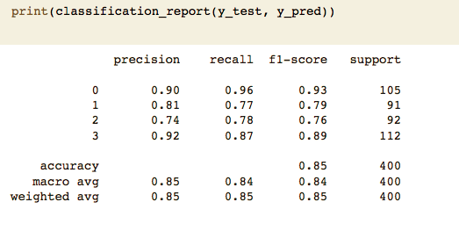
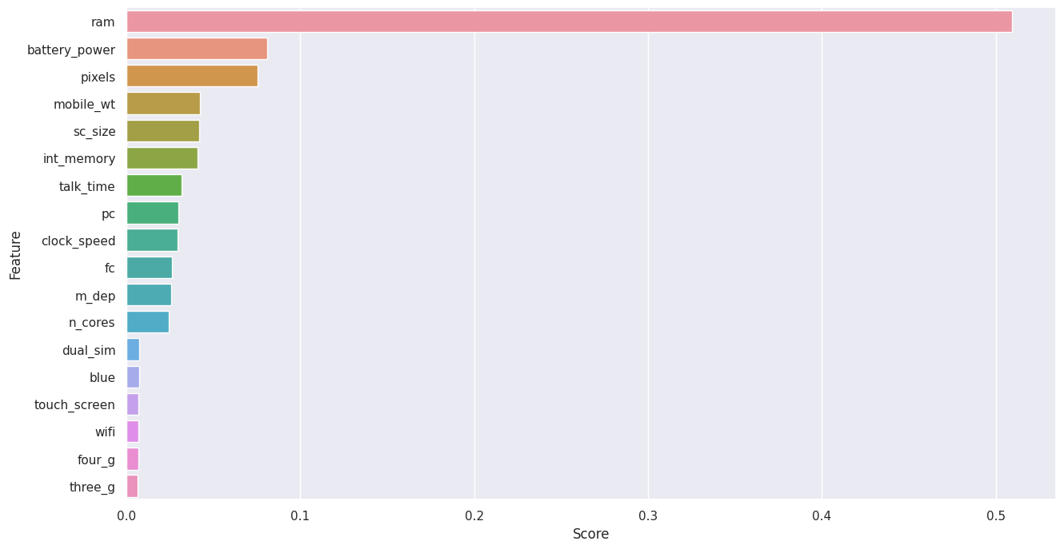
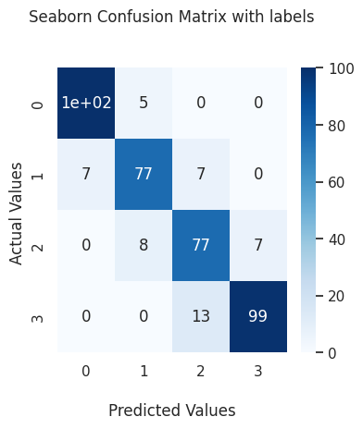
Random Forest Classifier With Hyper parameter Tuning
As we can see the top 3 important features of our dataset are: RAM, battery_power ,pixels

Slide 16
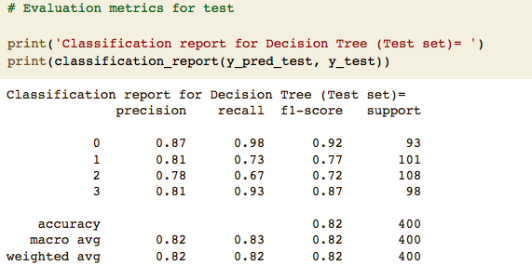
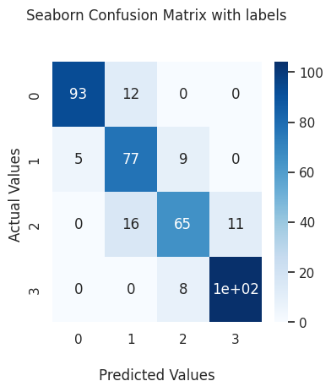
Decision Tree
Decision Tree with hyperparameter tuning
^{Test_accuracy : 84%}
^{Test_accuracy : 84%}
^{Test_accuracy : 82%}

Slide 17
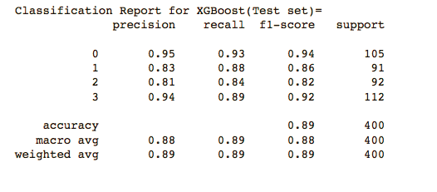
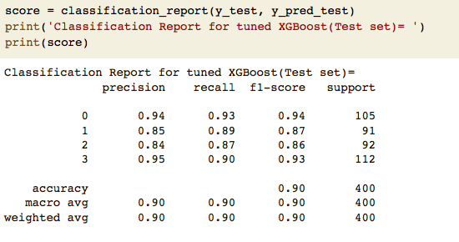
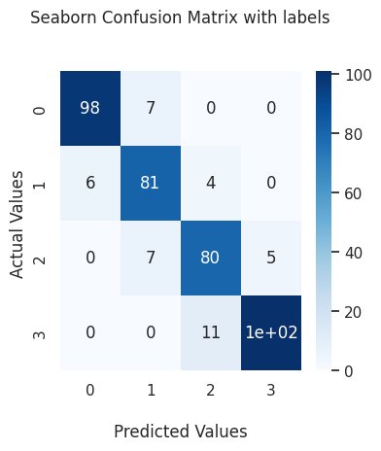
Xgboost XGboost WithHyperparameterTuning
^{Test_accuracy : 89%}
^{Test_accuracy : 90%}

Slide 18
Conclusion
● From EDA, we can see that there are mobile phones in 4 price ranges.
The number of elements is almost similar.
● Half the devices have Bluetooth, and half doesn’t.
● There is a gradual increase in battery as the price range increases.
● Ram has continuous increase with price range while moving from Low cost to Very high cost.
● Costly phones are lighter.
● RAM, battery power, pixels played more significant role in deciding the price range of mobile
phone.
● From all the above experiments, we can conclude that logistic regression and XGboosting with
using hyperparameters we got the best results.
● The accuracy and performance of the model is evaluated by using confusion matrix.

Slide 19
Thank You

